Slide 1
Twitter Sentiment Analysis

Slide 2
Table of Contents
Introduction
Understand the Problem Statement
Tweets Preprocessing and Cleaning
Story Generation and Visualization from Tweets
Extracting Features from Cleaned Tweets
Model Building: Sentiment Analysis

Slide 3
Sentiment analysis?
Sentiment analysis is the process of determining whether a piece of writing is positive ,negative or neutral.
Sentiment analysis models focus on polarity (positive, negative, neutral) but also on feelings and emotions (angry, happy, sad, etc),

Slide 4
Why is sentiment analysis is important
It’s estimated that 80% of the world’s data is unstructured, in other words it’s unorganized. Huge volumes of text data is created every day: emails, support tickets, chats, social media conversations, surveys, articles, documents, etc). But it’s hard to analyze, understand, and sort through, not to mention time-consuming and expensive.
Sentiment analysis, however, helps businesses make sense of all this unstructured text by automatically understanding, processing, and tagging it.
In public opinions eg:
Is the product review positive or negative
Based on a sample of tweet,how people responding to this ad campaign/product release /news item?
How have the bloggers attitudes about the president changed since election?

Slide 5
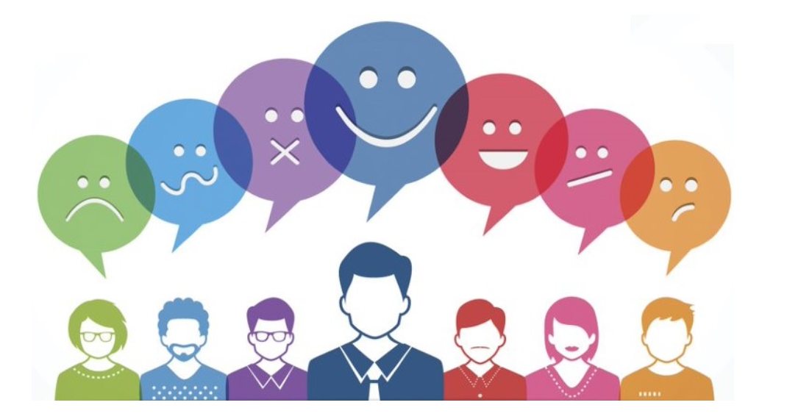

Slide 6
1. Understand the Problem Statement
The objective of this task is to detect hate speech in tweets. For the sake of simplicity, we say a tweet contains hate speech if it has a racist or sexist sentiment associated with it. So, the task is to classify racist or sexist tweets from other tweets.
Formally, given a training sample of tweets and labels, where label ‘1’ denotes the tweet is racist/sexist and label ‘0’ denotes the tweet is not racist/sexist, your objective is to predict the labels on the given test dataset.
Note: The evaluation metric from this practice problem is F1-Score.

Slide 7
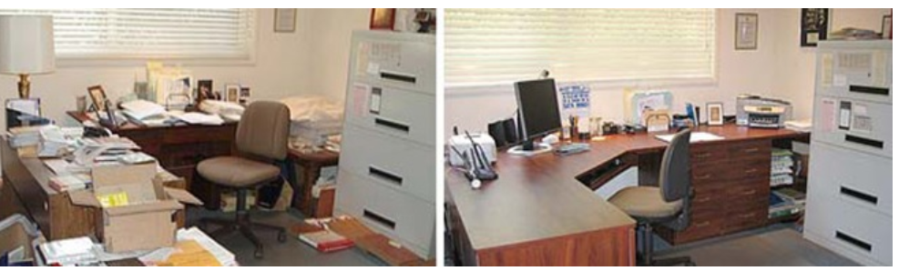
2. Tweets Preprocessing and Cleaning

Slide 8
A) Removing Twitter Handles (@user)
The tweets contain lots of twitter handles (@user), that is how a Twitter user acknowledged on Twitter. We will remove all these twitter handles from the data as they don’t convey much information.
B) Removing Punctuations, Numbers, and Special Characters
Punctuations, numbers and special characters do not help much. It is better to remove them from the text just as we removed the twitter handles. Here we will replace everything except characters and hashtags with spaces.

Slide 9
C) Removing Short Words
We have to be a little careful here in selecting the length of the words which we want to remove. So, I have decided to remove all the words having length 3 or less. For example, terms like “hmm”, “oh” are of very little use. It is better to get rid of them.
D) Tokenization
Tokens are individual terms or words, and tokenization is the process of splitting a string of text into tokens.
E) Stemming
Stemming is a rule-based process of stripping the suffixes (“ing”, “ly”, “es”, “s” etc) from a word. For example, For example – “play”, “player”, “played”, “plays” and “playing” are the different variations of the word – “play”.

Slide 10
3. Story Generation and Visualization from Tweets
What are the most common words in the entire dataset?
What are the most common words in the dataset for negative and positive tweets, respectively?
How many hashtags are there in a tweet?
Which trends are associated with my dataset?
Which trends are associated with either of the sentiments? Are they compatible with the sentiments?

Slide 11
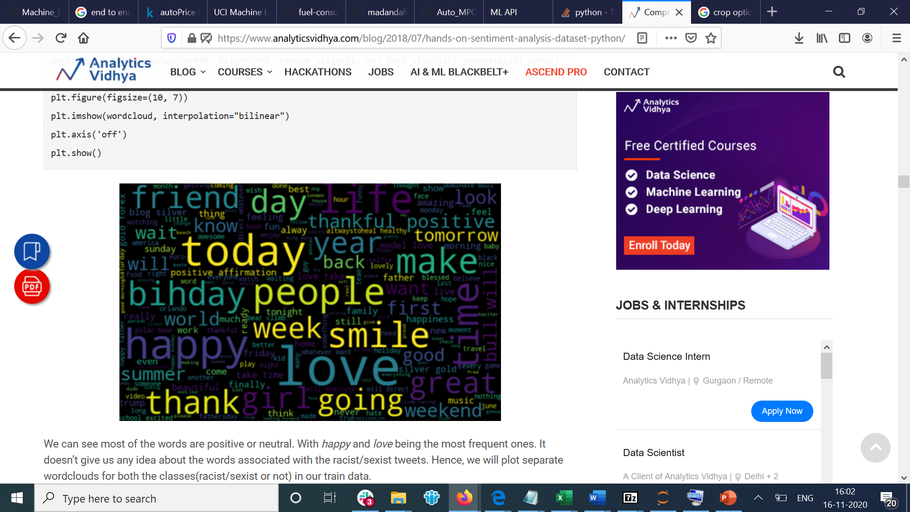
A) Understanding the common words used in the tweets: WordCloud
A wordcloud is a visualization wherein the most frequent words appear in large size and the less frequent words appear in smaller sizes.
We can see most of the words are positive or neutral. With happy and love being the most frequent ones. It doesn’t give us any idea about the words associated with the racist/sexist tweets.

Slide 12
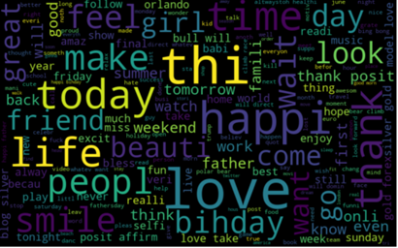
B) Words in non racist/sexist tweets
we can see most of the words are positive or neutral. With happy, smile, and love being the most frequent ones. Hence, most of the frequent words are compatible with the sentiment which is non racist/sexists tweets.

Slide 13
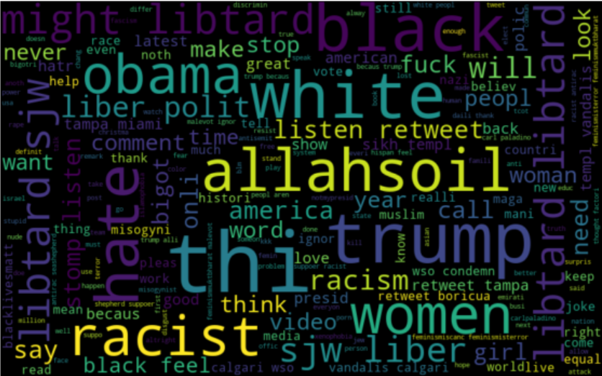
C) Racist/Sexist Tweets
As we can clearly see, most of the words have negative connotations. So, it seems we have a pretty good text data to work on. Next we will the hashtags/trends in our twitter data.

Slide 14
D) Understanding the impact of Hashtags on tweets sentiment
Hashtags in twitter are synonymous with the ongoing trends on twitter at any particular point in time. We should try to check whether these hashtags add any value to our sentiment analysis task
“what has todays attitude to women got in common with that of norman bates?#psycho#feminism#Hollaback”
The tweet seems sexist in nature and the hashtags in the tweet convey the same feeling.i.e., they help in distinguishing tweets into the different sentiments.

Slide 15
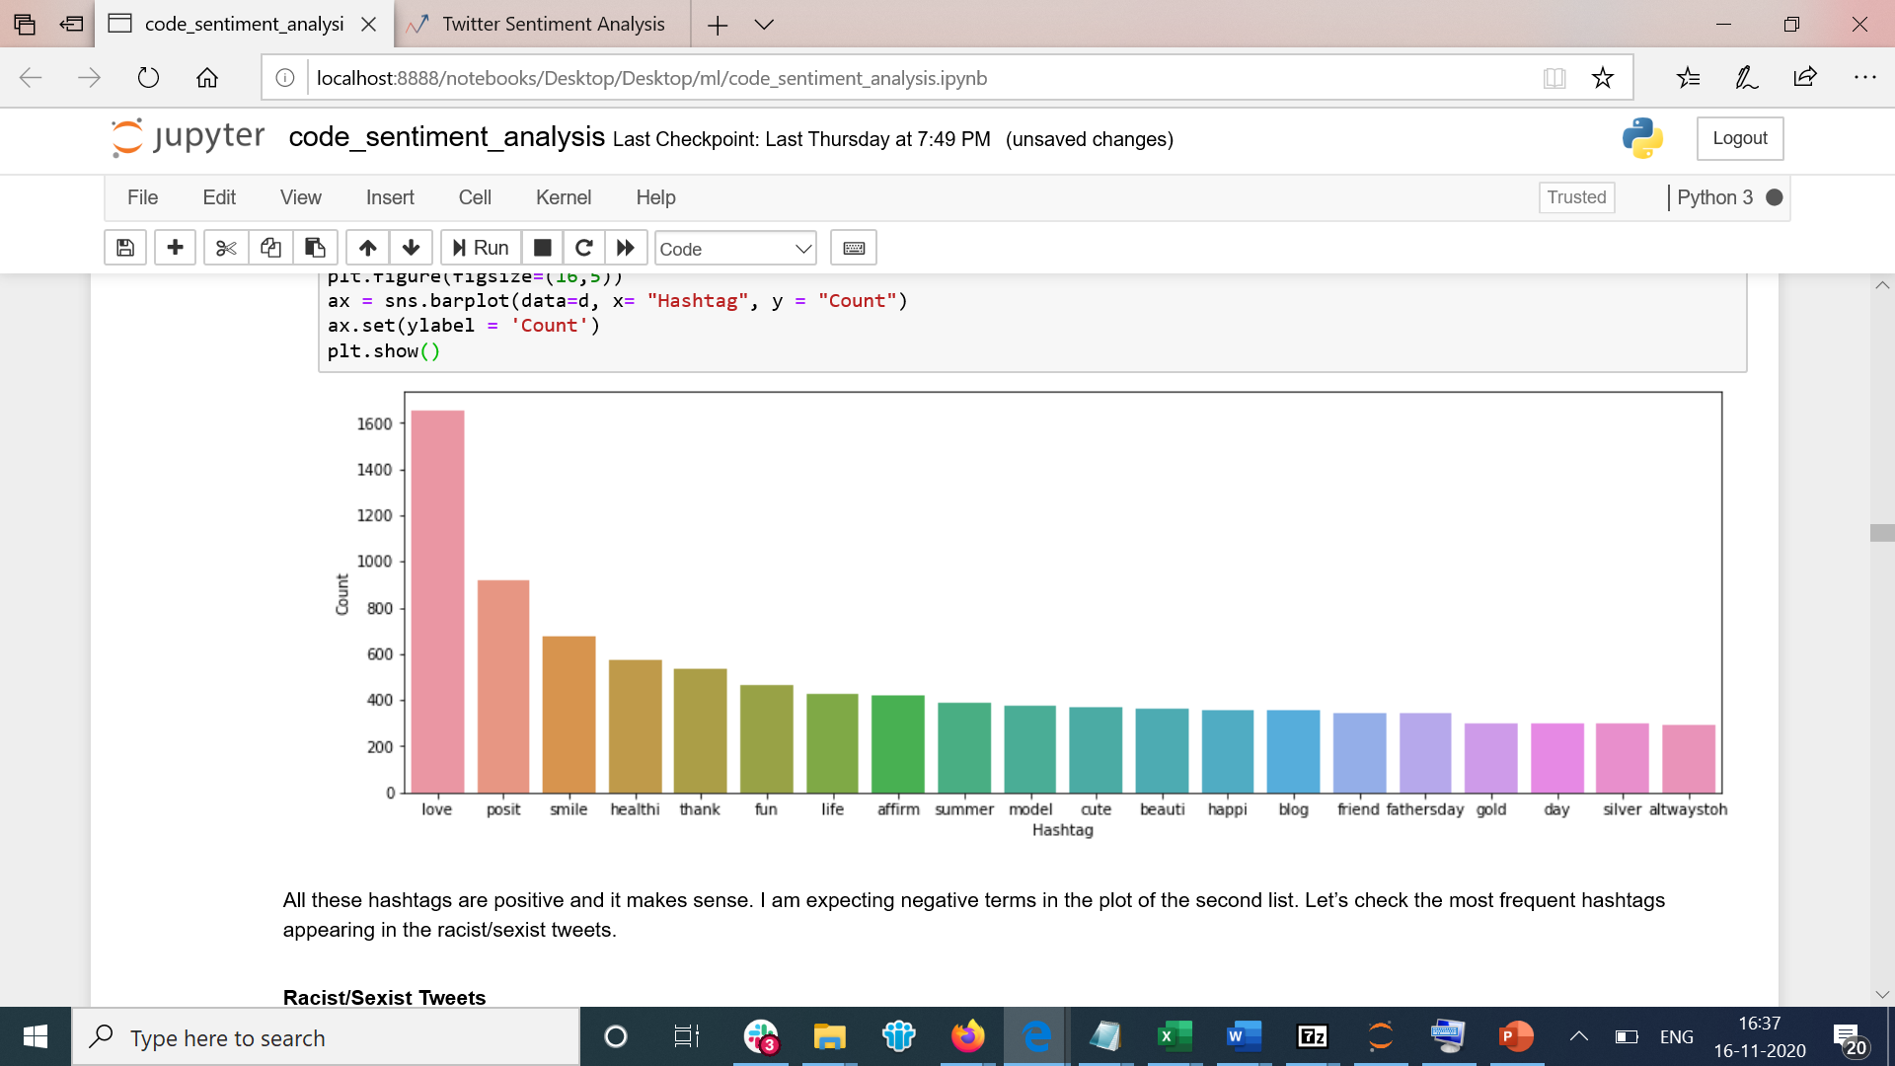
Non-Racist/Sexist Tweets

Slide 16
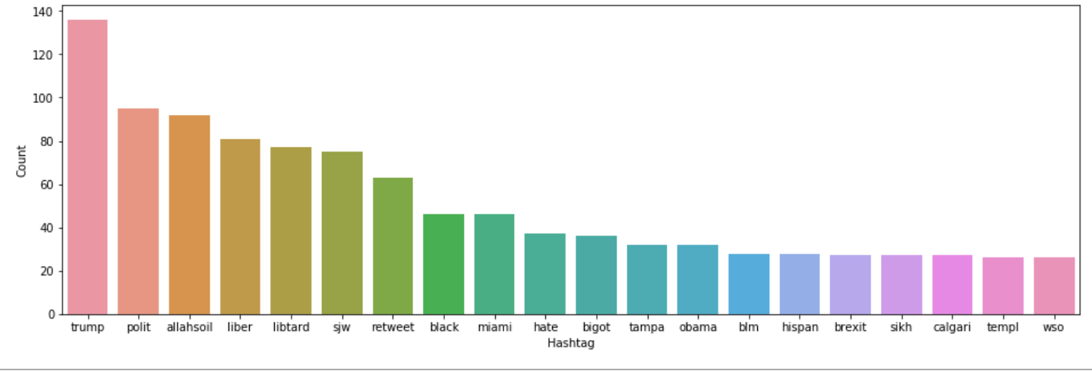
Racist/Sexist Tweets

Slide 17
4. Extracting Features from Cleaned Tweets
Bag-of-Words Features
TF-IDF Features
Word2vec
doc2vec

Slide 18
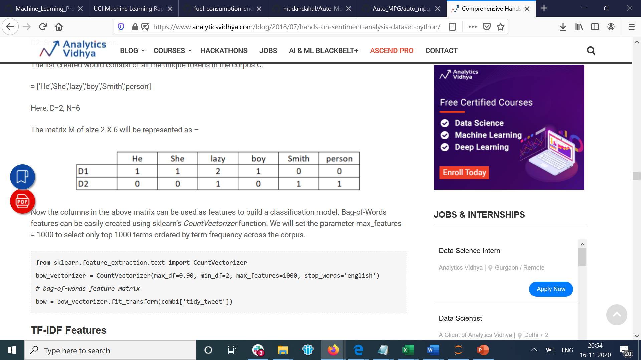
Bag-of-Words Features
Bag-of-Words is a method to represent text into numerical features
D1: He is a lazy boy. She is also lazy.
D2: Smith is a lazy person.
The list created would consist of all the unique tokens in the corpus C.
= [‘He’,’She’,’lazy’,’boy’,’Smith’,’person’]
Here, D=2, N=6
The matrix M of size 2 X 6 will be represented as

Slide 19
TF-IDF Features
TF-IDF works by penalizing the common words by assigning them lower weights while giving importance to words which are rare in the entire corpus but appear in good numbers in few documents.
let’s have a look at the important terms related to TF-IDF:
TF = (Number of times term t appears in a document)/(Number of terms in the document)
IDF = log(N/n), where, N is the number of documents and n is the number of documents a term t has appeared in.
TF-IDF = TF*IDF

Slide 20
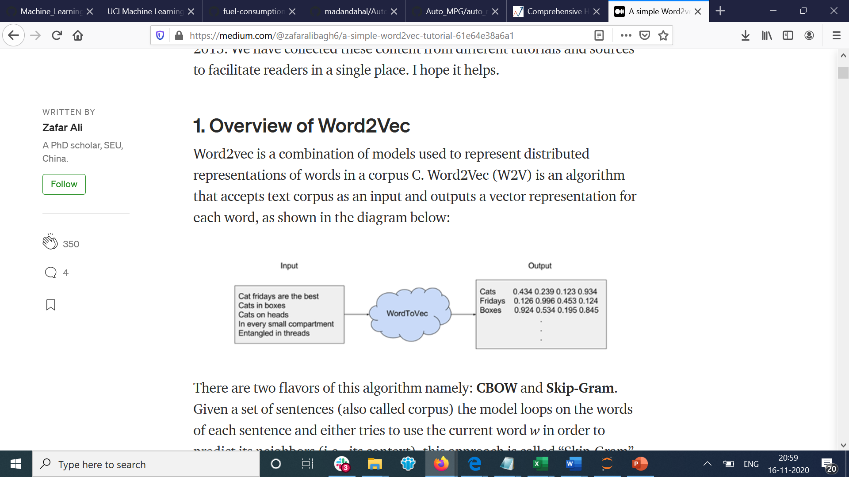
Word2vec Features
Word2vec is a three layer neural network with one input, one hidden and an output layer. Word2Vec (W2V) is an algorithm that accepts text corpus as an input and outputs a vector representation for each word, as shown in the diagram below:

Slide 21
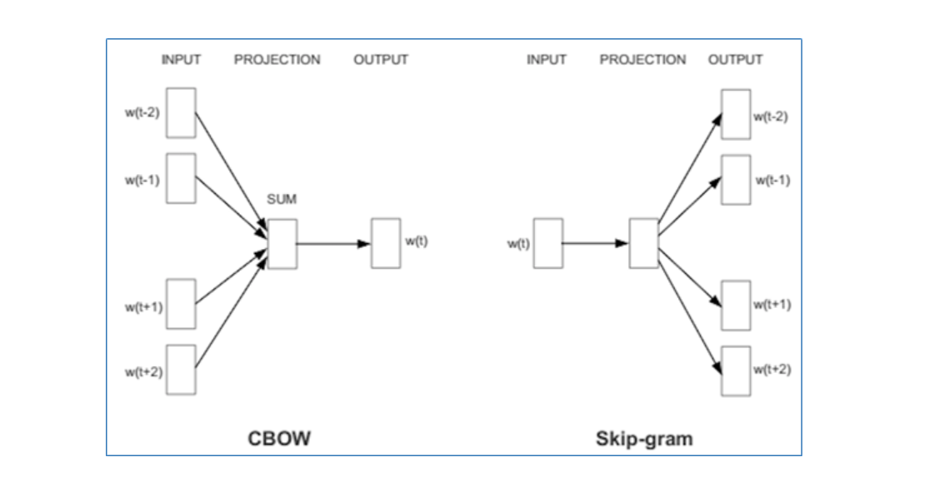
Techniques In word2vec

Slide 22
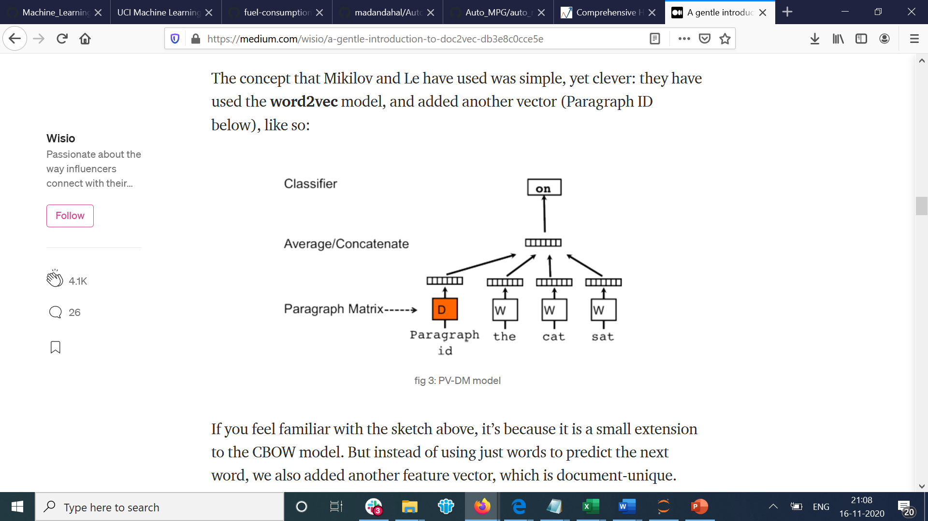
Doc2vec
Doc2Vec is an unsupervised algorithm that learns fixed-length feature vectors for paragraphs/documents/texts. For understanding the basic working of doc2vec , how the word2vec works needs to be understood as it uses the same logic except the document specific vector is the added feature vector.

Slide 23
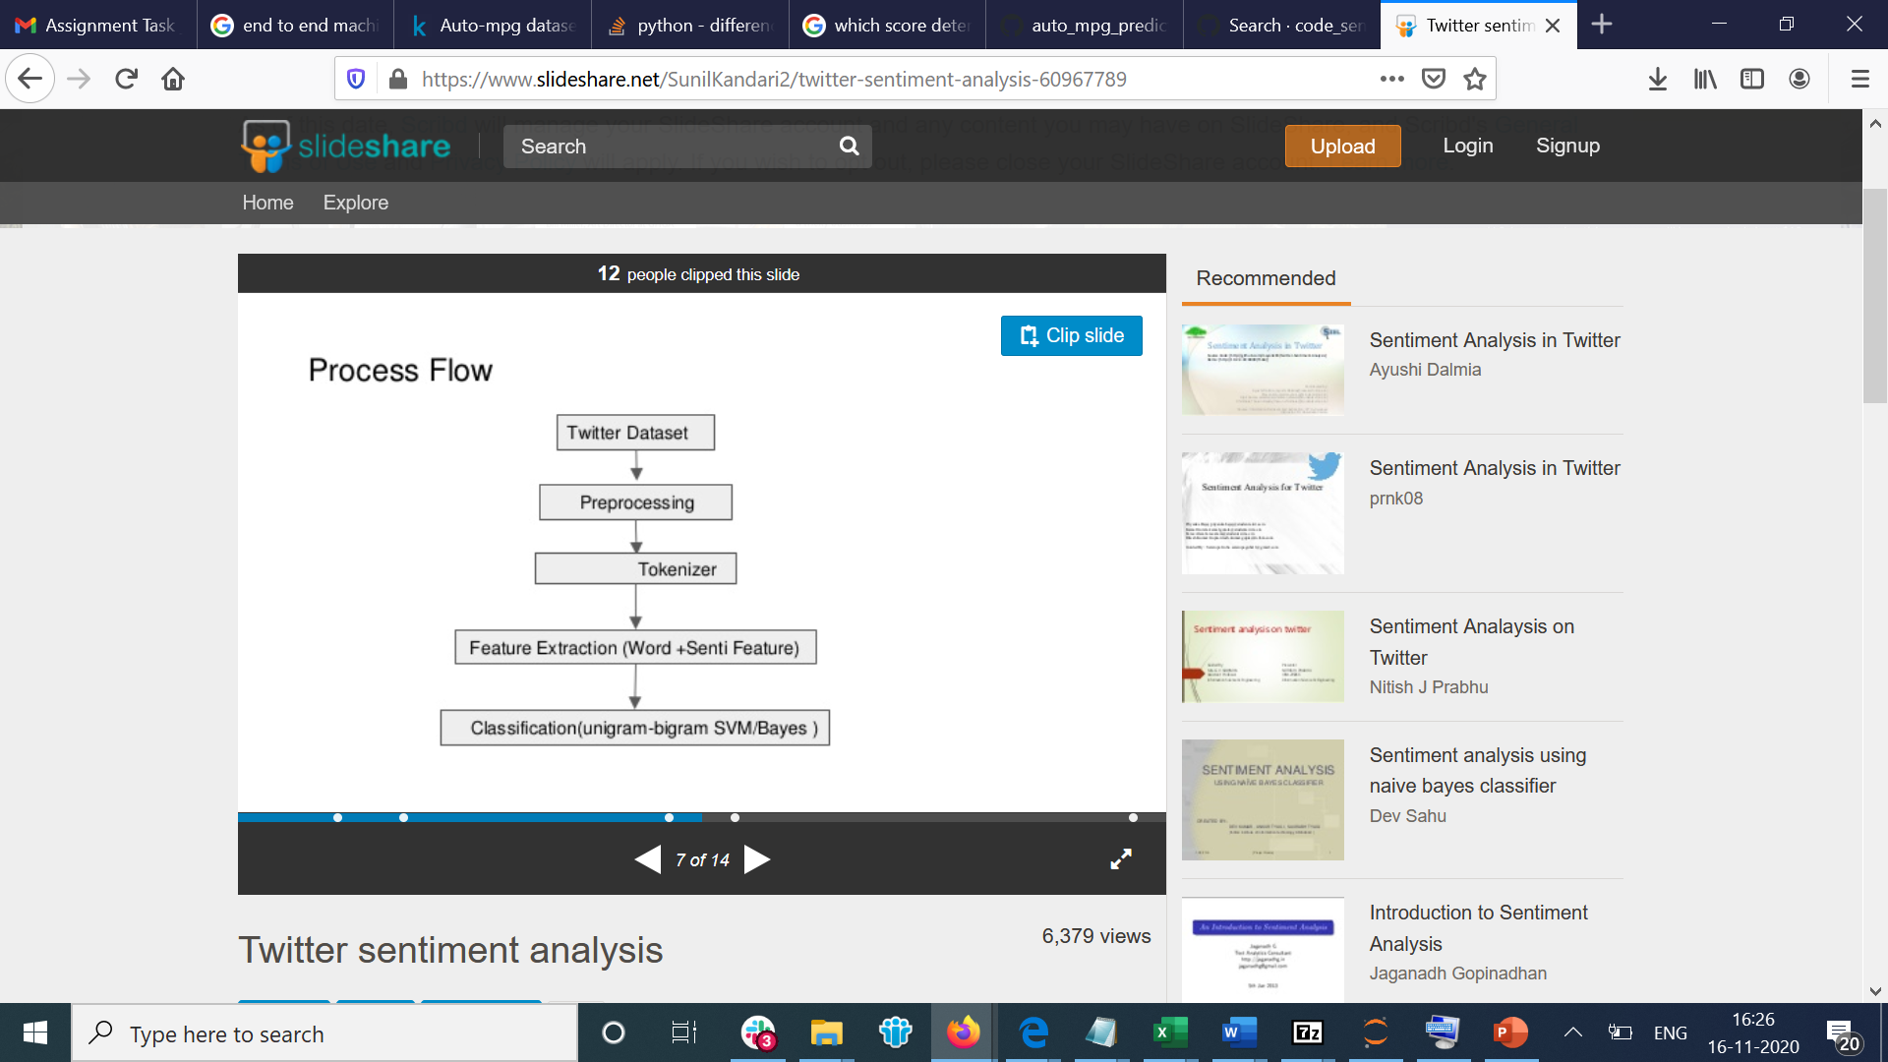

Slide 24
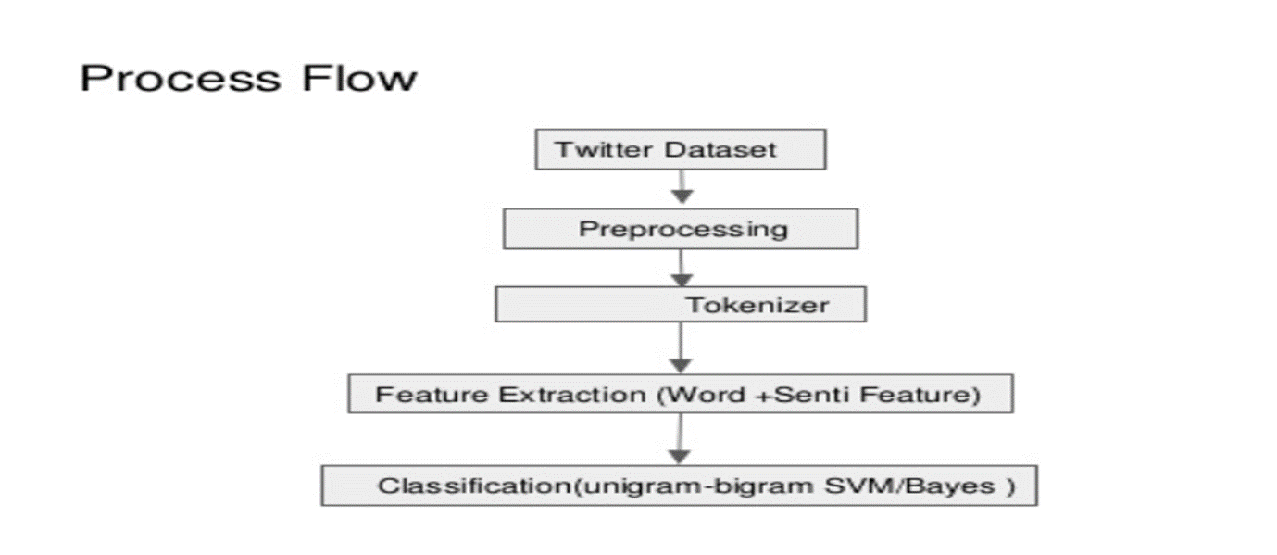
5. Model Building: Sentiment Analysis

Slide 25
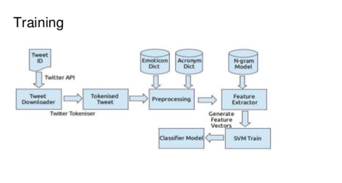

Slide 26
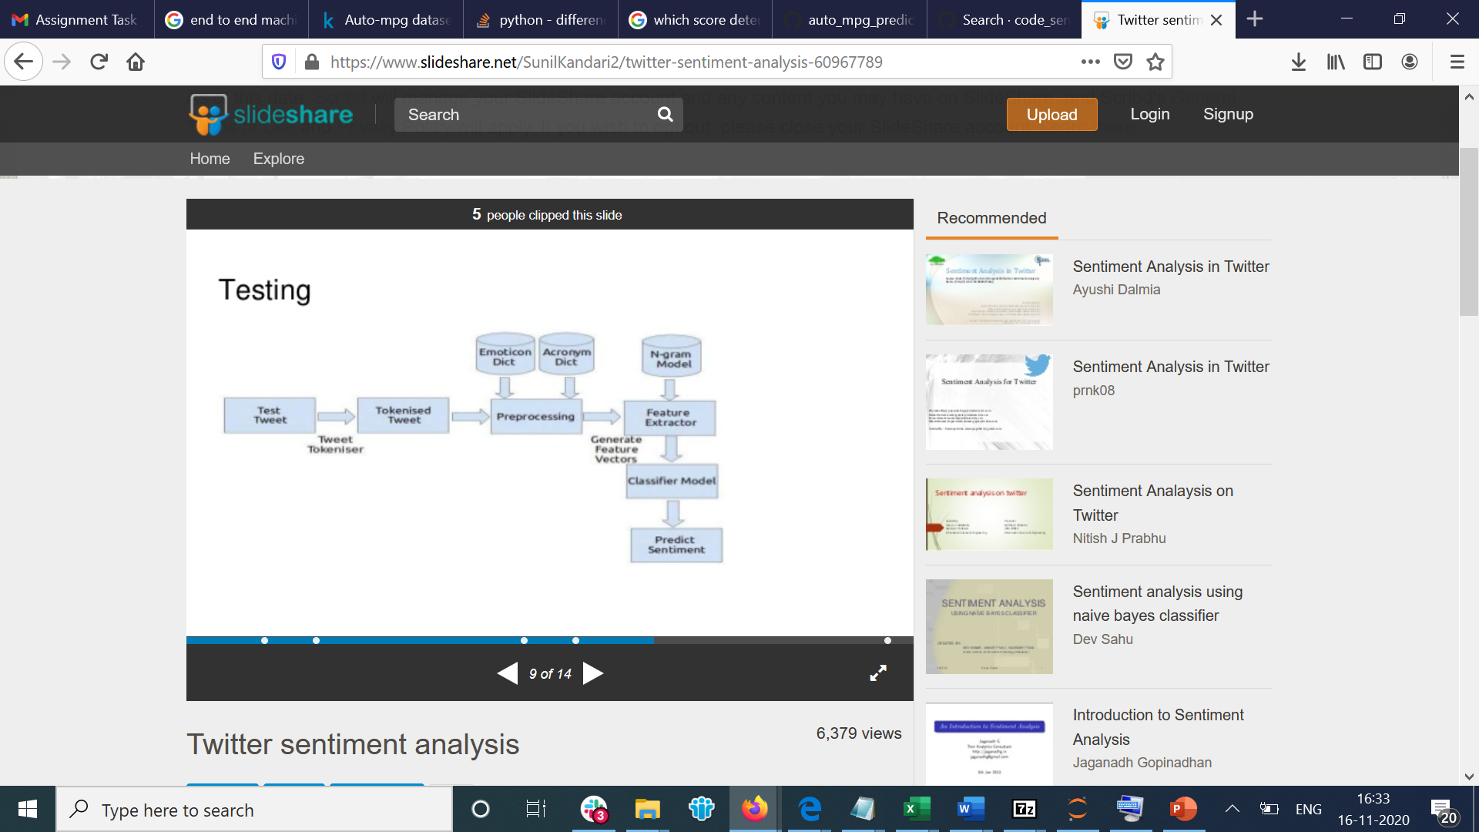

Slide 27
Models which I have used:
Logistic regression
SVM(Support Vector Machine)
Random Forest
Xg Boost

Slide 28
F1Score:
 | Logisctic Regression | SVM | Random Forest | XG Boost
BOW | 0.53034081463 | 0.50882079851 | 0.55292259083 | 0.52477064220
TFIDF | 0.54513274336 | 0.51001821493 | 0.56215213358 | 0.53942652329
Word2Vec | 0.61458333333 | 0.59843750000 | 0.50431034482 | 0.64700625558
Doc2Vec | 0.37823834196 | 0.19679633867 | 0.06770098730 | 0.38626609442

Slide 29
Time
 | Logisctic Regression | SVM | Random Forest | XG Boost
BOW | 498 ms | 40.8 s | 41 s | 2min 26s
TFIDF | 283 ms | 27.2 s | 47.9 s | 21.7 s
Word2Vec | 1.12 s | 2min 19s | 2min 23s | 5min 20s
Doc2Vec | 699 ms | 3min 42s | 2min 26s | 5min 56s

Slide 30
Conclusion:
XGBoost model on word2vec features has performed well
We can further increase the accuracy of the model by using Hyperparameter tuning techniques

Slide 31
Thank You

